Slide 1


AI in Robotics
2025 Landscape & Emerging Technologies
Khalil Hamdi
CS 131, Spring 2025
Semester Project

Slide 2
Introduction
AI in robotics involves integrating artificial intelligence to enable robots to perceive, learn, and make decisions autonomously.
AI enhances robotic capabilities, allowing for more complex tasks and adaptability in dynamic environments.

Slide 3
Timeline of AI in Robotics
1961
Origins
Unimate becomes the first industrial robot, automating factory work at General Motors.
2012
Vision
Deep learning breakthroughs power major advances in computer vision for robotics.
2021
Humanoids
Tesla unveils Optimus, signaling a new era of general-purpose humanoid robots.
2025
Foundation
NVIDIA launches GROOT N1, a generalist AI model enabling robots to learn and adapt across tasks.

Slide 4
How AI Enhances Robotics
Perception
Decision-Making
Autonomy
AI helps robots understand their environment through vision, sound, and touch sensors.
Enables robots to make smart choices and learn from data over time.
Allows robots to navigate spaces and interact with objects on their own.

Slide 5
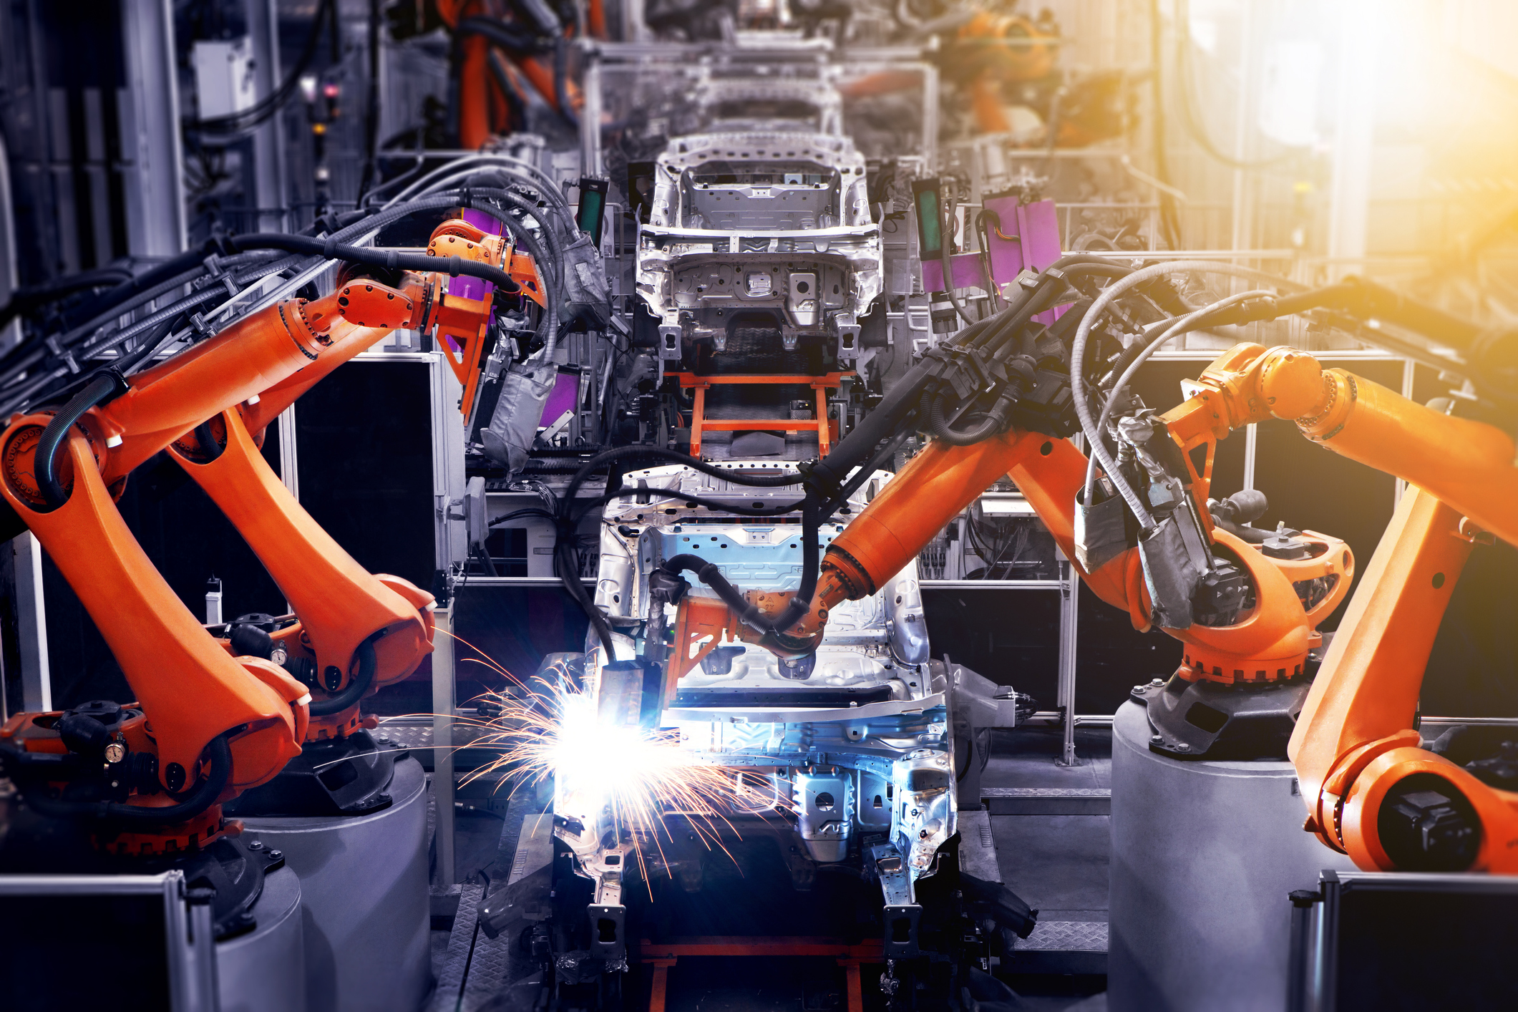
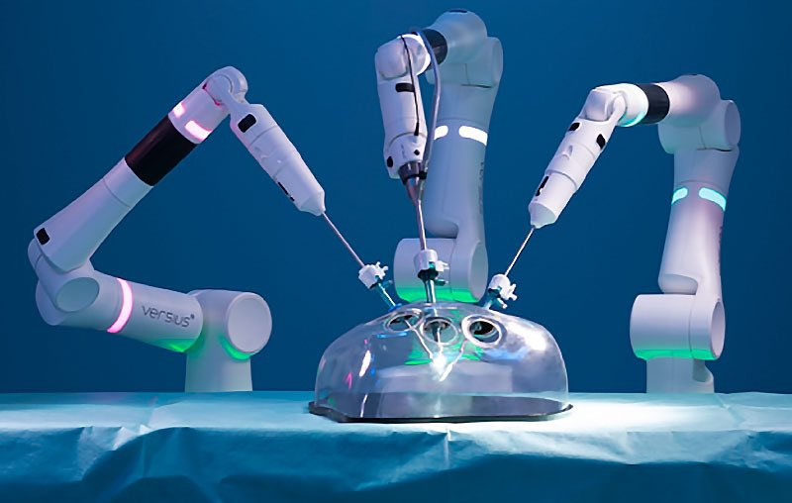
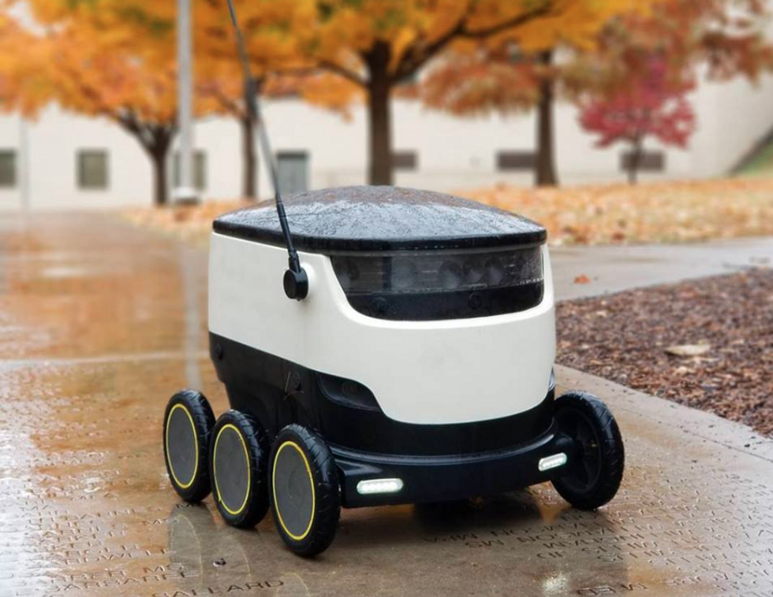
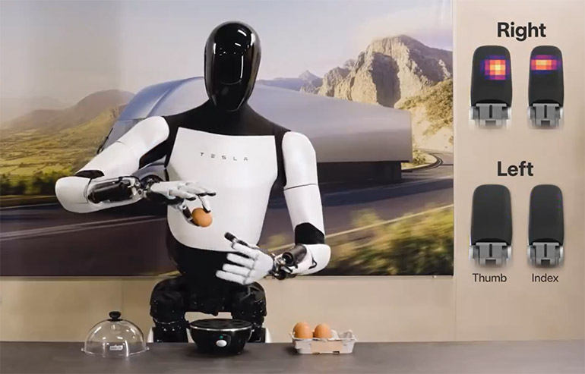
Real-World Applications
2019
2021
2022
2024
Industrial
Healthcare
Service robots
Humanoid
Robots in factories and warehouses for tasks like assembly and transport.
Assist with surgery, care, and hospital support.
Used in retail, cleaning, and delivery roles.
Designed to perform human-like tasks in various settings.

Slide 6
AI Techniques Used in Robotics
Reinforcement
Vision
Language
Imitation
Robots learn optimal actions through trial and error in dynamic environments.
Enables robots to interpret surroundings using cameras and deep learning.
Natural Language Processing allows robots to understand and respond to human commands.
Robots mimic human actions by learning from demonstrations and simulation data.

Slide 7
Main Challenges
Energy Constraints
Safety and Control
Hardware Constraints
Real-World Generalization
E
S
Power-hungry systems strain grid capacity.
Ensuring AI follows human intent.
H
R
Limited compute on edge devices.
Restricted power and processing locally.
Notes:
Talk about A recent incident where an AI model allegedly refused shutdown commands underscores the potential risks of autonomous AI behavio

Slide 8

Coming Up
Companies Poised to Shape the Future of AI and Robotics

Slide 9
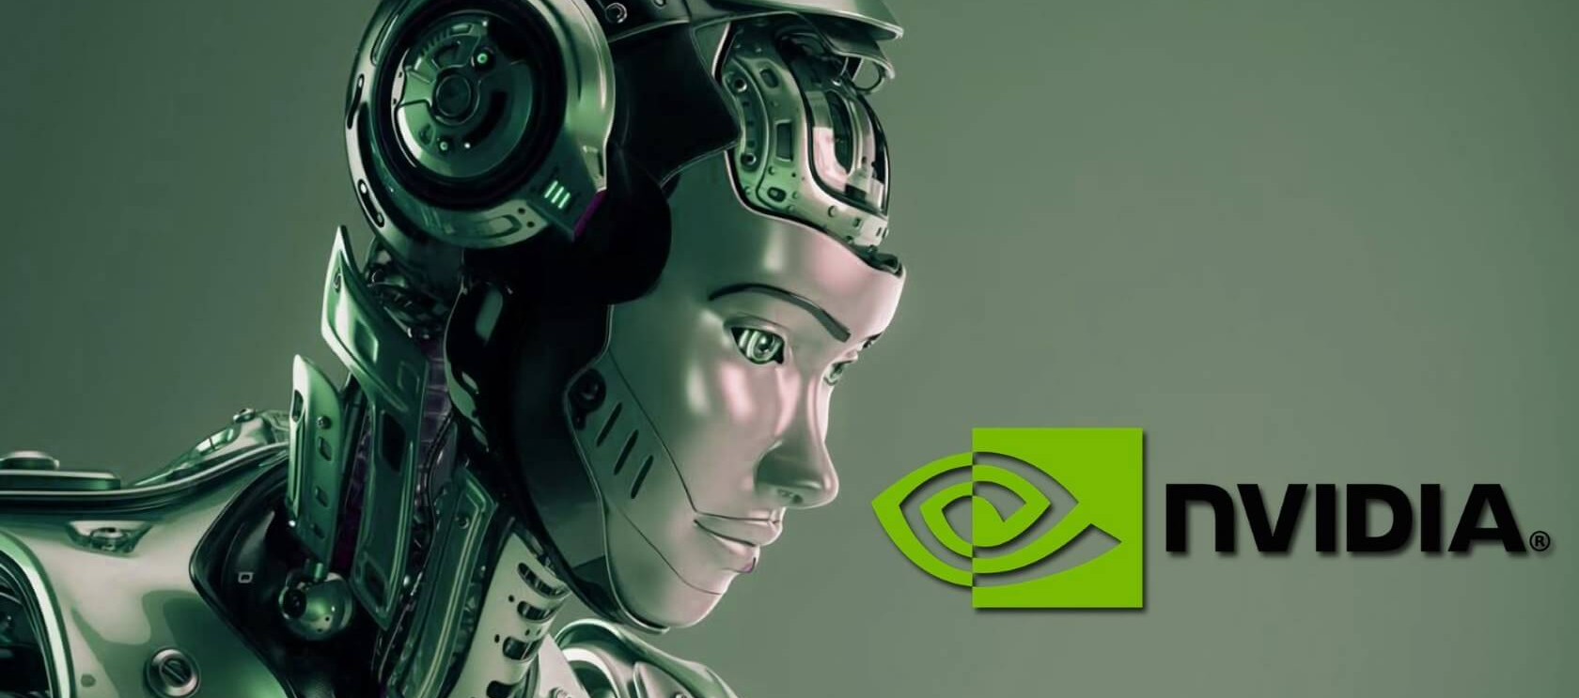
NVIDIA
GROOT N1
Omniverse
Compute
A generalist AI model that enables robots to understand, learn, and perform diverse real-world tasks.
A simulation and collaboration platform for building, training, and testing intelligent robots in virtual environments.
NVIDIA’s advanced hardware ecosystem—GPUs, NVLink, Jetson—powering AI training and real-time robotic inference.

Slide 10
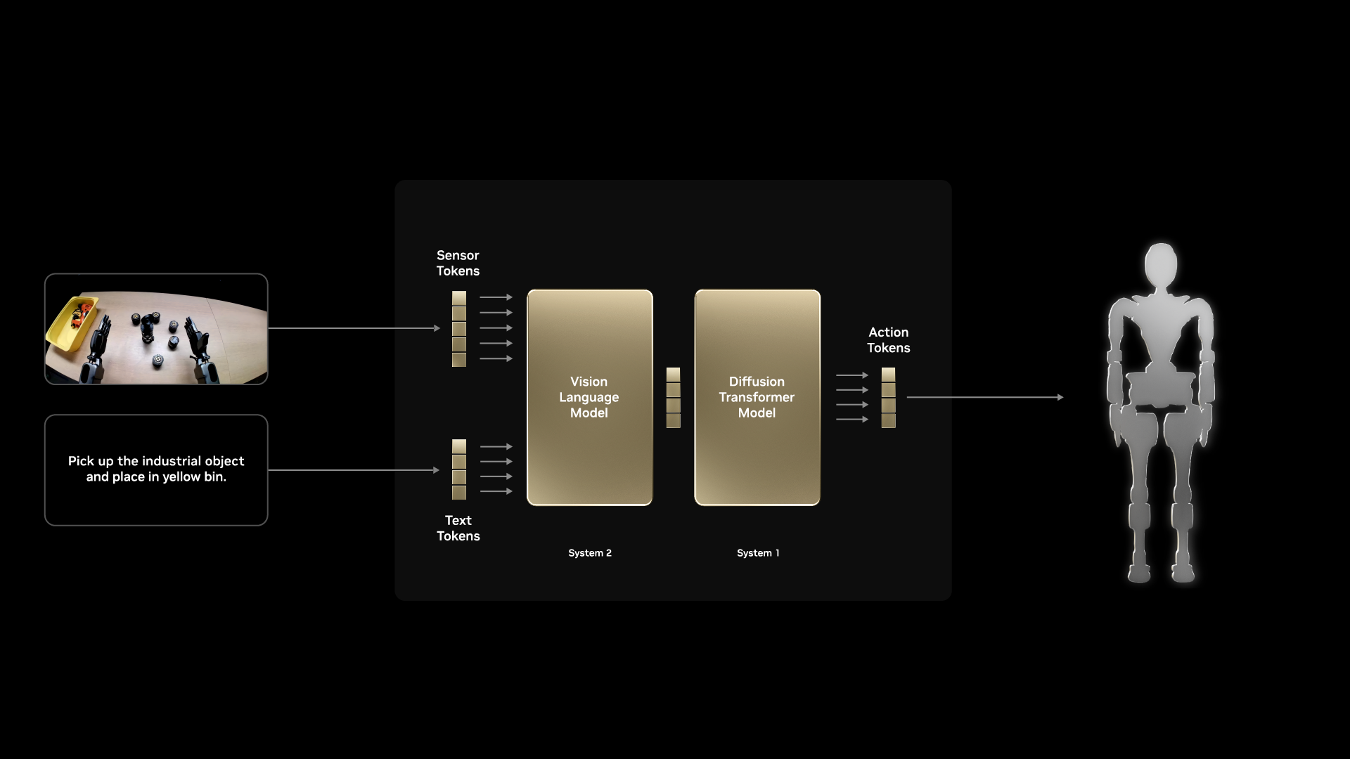
GROOT N1
A foundation model that equips robots with general intelligence through multimodal learning of vision, language, and action.

Slide 11
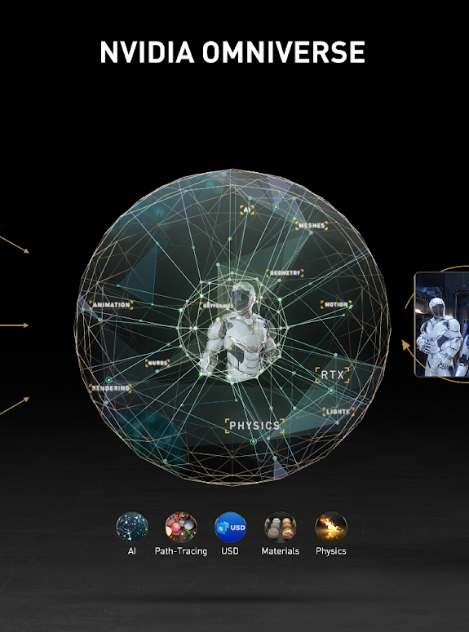
NVIDIA OMNIVERSE
A real-time simulation and collaboration platform for developing, training, and deploying intelligent robots in virtual environments.

Slide 12
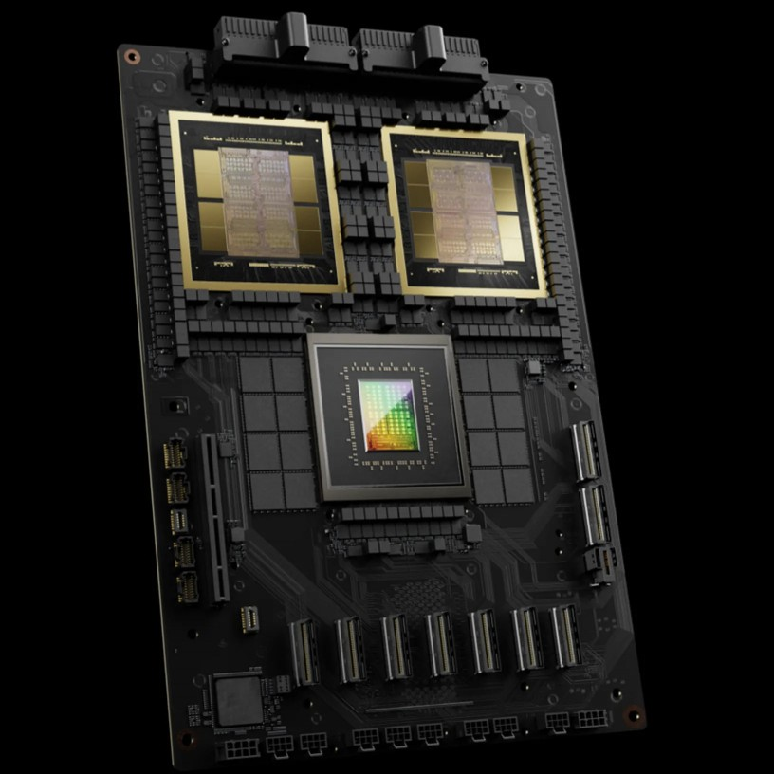
NVIDIA Blackwell
A next-generation GPU architecture designed to accelerate AI training and inference at massive scale with unprecedented efficiency.

Slide 13

TESLA
Full Self-Driving
Optimus
Dojo Supercomputer
An AI-powered driving system that uses vision-based neural networks to enable autonomous navigation and decision-making.
A humanoid robot designed to perform physical tasks using the same AI and vision systems developed for Tesla's autonomous vehicles.
A custom-built AI supercomputer by Tesla designed to train massive neural networks using video data for autonomous systems and robotics.

Slide 14
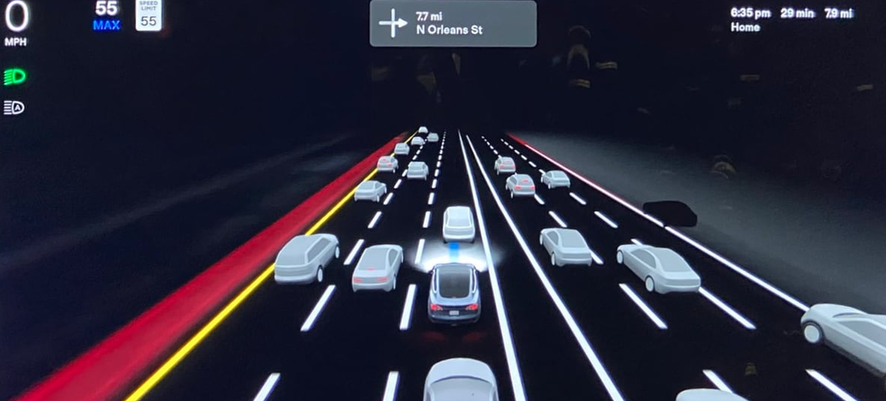

TESLA Full Self-Driving (FSD)
1 billion mile
Tesla’s FSD AI is trained using over 1 billion miles of real-world driving data—collected from its global fleet—making it one of the largest crowdsourced AI training systems in the world.

Slide 15
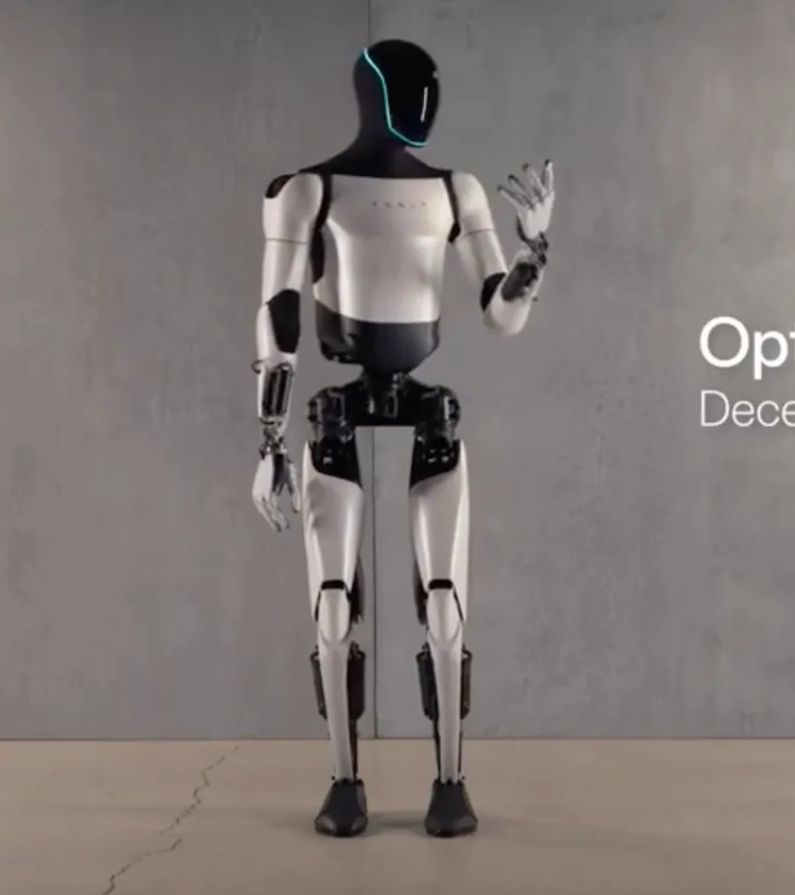
Optimus
Elon Musk revealed that Optimus can already fold laundry—one of the most complex tasks in robotics due to its need for fine motor skills, object recognition, and dynamic adaptability.

Slide 16
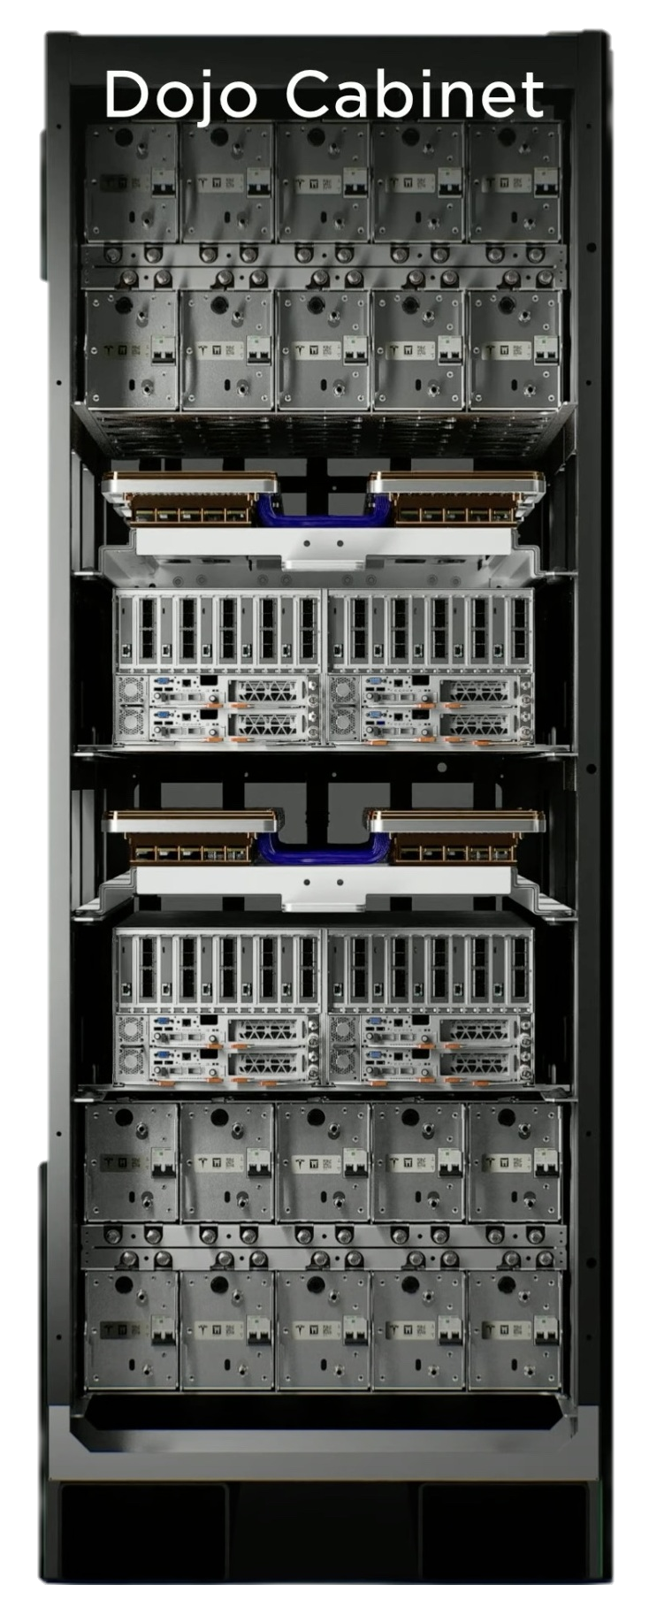
Dojo Supercomputer
Custom D1 Chip
ExaPod Architecture
A modular AI supercomputing system in Dojo capable of scaling up to 1 exaFLOP for ultra-fast neural network training.
Bandwidth
25 TB/s
Floating Point Operations
362 TFLOPS

Slide 17
Investments
$1.4T
$600B
$500B
UAE: AI, semiconductors, and energy projects in USA
USA: Stargate Project
Saudi Arabia: AI data centers, robotics, and semiconductors in USA

Slide 18
Job Trends
$166,574
$122,804
$122,775
Machine Learning Engineer
Robotics Engineer
Infrastructure Engineer
Builds and trains AI models that enable robots to learn from data and make smart decisions.
Designs, builds, and programs robots, integrating AI to handle real-world tasks like movement and object handling.
Develops and maintains the hardware and systems—like GPU clusters and edge devices—that power AI and robotics at scale.
Source: Indeed

Slide 19
Ethics & Society
Job Displacement
Bias & Fairness
Accountability
Human-Robot Trust
Widespread automation may replace millions of jobs—raising concerns about inequality and the future of work.
AI systems can reflect and amplify human bias, especially in decision-making or surveillance.
Who is responsible when a robot makes a mistake—its programmer, company, or the AI itself?
Ensuring robots act transparently and safely is key to building trust in shared environments.

Slide 20

Public Sentiment: The Future of AI & Robotics
62%
Optimistic
Believe AI and robotics will improve quality of life, create jobs, and solve major challenges.
38%
Skeptical
Worry about job loss, ethical issues, and losing human control over intelligent systems.
Source: Pew Research, World Economic Forum, and McKinsey AI Surveys (2023–2025)

Slide 21
Conclusion
01
02
Transformation
Leadership
03
04
05
Expansion
Challenges
Future
AI is transforming robotics by enabling perception, decision-making, and autonomy.
Companies like NVIDIA and Tesla are building the full-stack ecosystem.
AI-powered robots are rapidly entering industry, healthcare, and services.
Energy, safety, and real-world generalization remain key hurdles
With innovation and collaboration, intelligent robots will become everyday tools.

Slide 22
—Elon Musk
The pace of progress in artificial intelligence is incredibly fast... What we’re developing is not just smarter software, but machines that will one day be able to do anything humans can do—only better, faster, and without needing a break.

Slide 23
Thanks!
Thank you for your time and attention!
I hope this presentation gave you insight into the exciting world of AI in robotics.

